Slide 1

On Becoming a Leader in Risk Management
Fundamentals of RM
RM System and Process
Leadership in RM
Incident Investigation
RM Tools & Challenges
RM in Industry
People & Org.
Application and Perspectives
ENGG404
RISK MANAGEMENT TOOLS
Chapter 5.3: Field Level Risk Assessment (FLRA)
1
Notes:
ENGG404 Lecture 00 - Day 1
2012 Fall
1
1
Aka FLHA

Slide 2
Learning Outcomes:
Explain the purpose of a variety of Risk Management tools, the manner in which these are used, and the benefits for planning and executing work.
FLRA, SQRA, JSA, Checklists
Explain the advantages and limitations of the tools.
Apply tools as a rudimentary skill of leadership to observe, interact, commend or intervene / coach employees in the work-place.
Chapter 5.6: Checklists for Executing Work
2
Notes:
2

Slide 3
Risk Management Tools:
FLRAs
SQRAs
JSAs
Checklists
Planned Inspections & Audits
Chapter 5.1: Tools for Risk Management
3

Slide 4
Purpose of an FLRA:
There are three key purposes of the FLRA:
It is for workers to assess hazards and to eliminate or control those hazards before starting to work (the job at hand).
It is used to share and communicate the nature of the job and the hazards associated with that job when working on a crew / team / group.
It is used to ensure understanding of the control measures to eliminate or mitigate the hazards when working on a crew / team / group.
Chapter 5.3: Field Level Risk Assessment
4

Slide 5
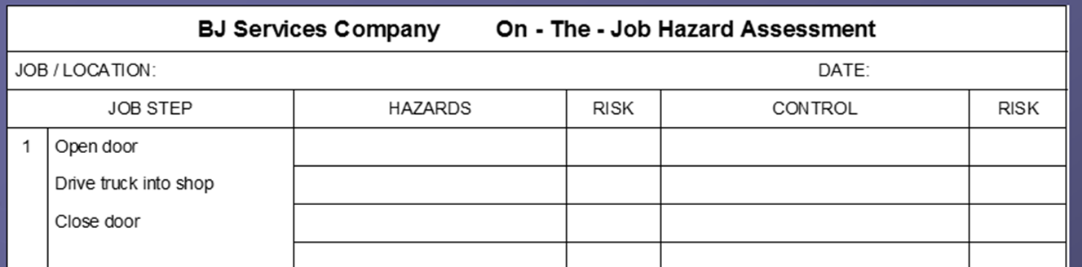
The Basic Steps to Create an FLRA:
Identify job and scope.
Determine major tasks, or tasks not anticipated in the JSA/SOP if being used.
Identify hazards associated with those tasks.
Determine risks posed by each hazard.
Identify suitable control measures for each hazard
Re-assess risk.
Most importantly, communicate / share the FLRA with co-workers.
Implement control measures, execute / perform / do the job.
Continually re-assess risk through-out the job.
Chapter 5.3: Field Level Risk Assessment
5

Slide 6
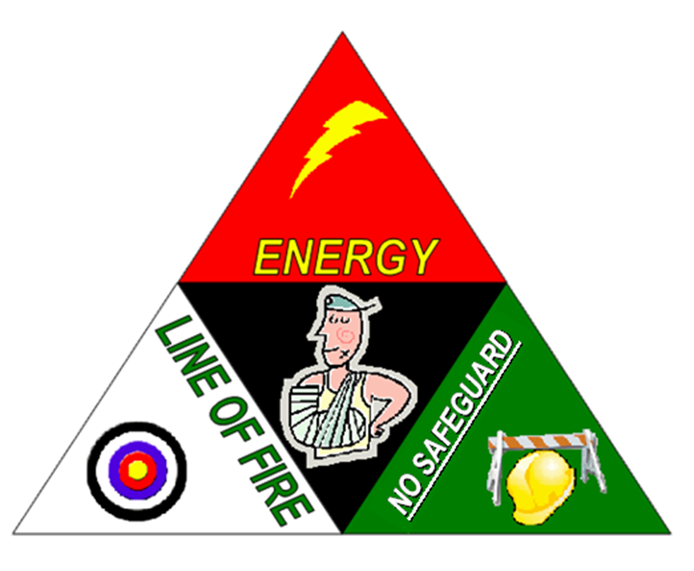
How do I Identify Hazards:
Remember from our “Discovery Model” for identifying hazards! Look for or think about the following:
Find the energy sources - mechanical, electrical, chemical, thermal etc.
Look for lack of or substandard safeguards (barriers)
Find the circumstances or mechanisms that will cause or trigger unwanted and uncontrolled releases.
Look for bodies, objects and environment that are in the line-of-fire and could be harmed by an uncontrolled energy release
Chapter 5.3: Field Level Risk Assessment
6

Slide 7
A Case Example: Environmental Drilling Program FLRA
Chapter 5.3: Field Level Risk Assessment
7

Slide 8
On Becoming a Leader in Risk Management
Fundamentals of RM
RM System and Process
Leadership in RM
Incident Investigation
RM Tools & Challenges
RM in Industry
People & Org.
Application and Perspectives
ENGG 404 Lecture
Chapter 5.4:
Semi-Quantitative Risk Assessment (SQRAs)
8
Notes:
ENGG404 Lecture 00 - Day 1
8
8

Slide 9
Risk Management Tools:
FLRAs
SQRAs
CCOHS JSAs
Checklists
Planned Inspections & Audits
Chapter 5.1: Tools for Risk Management
9

Slide 10
How to Conduct a Semi-Quantitative Risk Assessment:
Specific to the Hazard ID / Risk Assessment Procedure:
Identify hazards
Determine consequence
Determine likelihood
Assess risks
Determine precautions
Assess residual risk (that is, the risk level that you are willing to accept and now need to manage)
Decide follow-up actions
Chapter 5.4: Semi-Quantitative Risk Assessment
10
Notes:
10

Slide 11
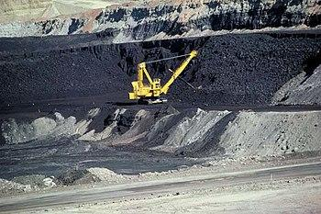
Example Semi-Quantitative Risk Assessment:
Remember the example from Chapter 4.2 and 4.3?
You are called to a scene where a mining haul truck and a shovel have been crushed with debris from an adjacent slope. You find one individual with a severe injury. You know the slopes are being monitored, you know there are procedures for safe work near the slopes, and you know it had been raining for the last week.
How could this incident have been prevented using SQRA?
Let’s work through an SQRA for this activity…
Chapter 5.4: Semi-Quantitative Risk Assessment
11
Notes:
11

Slide 12
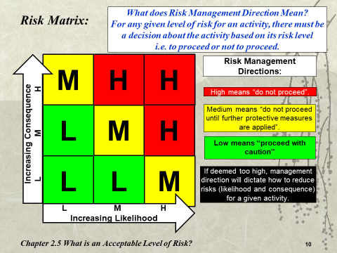
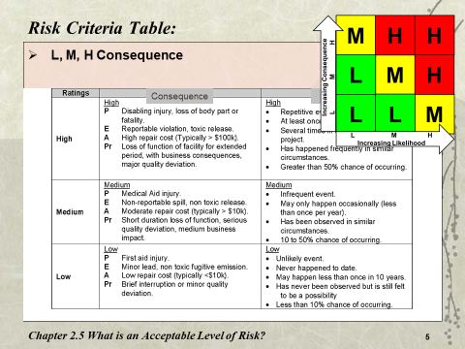
How to Conduct a Semi-Quantitative Risk Assessment:
Generic Semi-Quantitative Risk Assessment Table Template:
Activity | Deviation/ Concern | Likelihood | Conse-quence | Risk Before Control Measures | Control Measures / Safeguards | Change in Likelihood | Change in Conse-quence | Residual Risk | Proceed Y/N?
High
Low
Y
Chapter 5.4: Semi-Quantitative Risk Assessment
12
Notes:
12

Slide 13
Example Semi-Quantitative Risk Assessment:
Activity | Deviation/ Concern | Likelihood | Consequence | Risk Before Control Measures | Control Measures / Safeguards | Δ in Likelihood | Δ in Consequence | Residual Risk After Control Measures
Operator operating within the exclusion zone | Debris from slope failure injures operator and damages machine | M (Occurs <1X per yr, observed at other facilities) | H (Disabling injury or loss of life) | H | Institute an auditory alarm trigger for the slope monitoring system | L (Occurs <1x in 10 yrs) | H (Disabling injury or loss of life) | M
From Risk Matrix
From Risk Criteria Table
From Risk Criteria Table
Operator operating within the exclusion zone | Debris from slope failure injures operator and damages machine | M (Occurs <1X per yr, observed at other facilities) | H (Disabling injury or loss of life) | H | Install protective metal cage around cab of machine | M (Occurs <1X per yr, observed at other facilities) | L (First Aid injury) | L
Remember that the control measure(s) are typically designed to result in a reduction of likelihood or impact, usually not both!
Chapter 5.4: Semi-Quantitative Risk Assessment
13

Slide 14
On Becoming a Leader in Risk Management
Fundamentals of RM
RM System and Process
Leadership in RM
Incident Investigation
RM Tools & Challenges
RM in Industry
People & Org.
Application and Perspectives
ENGG404
Chapter 5.5:
The CCOHS Model for Job Safety Analysis (JSA)
Notes:
ENGG404 Lecture 00 - Day 1
2012 Fall
14
14

Slide 15
Risk Management Tools:
FLRAs
SQRAs
JSAs
Checklists
Planned Inspections & Audits
Chapter 5.1: Tools for Risk Management
15

Slide 16
Introduction:
The Job Safety Analysis Model (JSA): can be broadly applied to many jobs tasks and activities.
JSA is a documented plan for the safe execution of work that captures all hazards, consequences, risks, and controls associated with a job.
A JSA can be used to create and document a standard procedure for installing, operating, maintaining, overhauling, repairing, etc.
Safe Operating Procedure (SOP)
Safe Maintenance Procedure (SMP)
Chapter 5.5: The CCOHS Model for Job Safety Analysis
16
Notes:
16

Slide 17
What is the difference between a JSA & FLRA or SQRA?
JSA
Provides the generalized steps of a job task
Should be laid out before an FLRA/SQRA is completed
FLRA/SQRA
Is tailored to the specific task & environment at hand
Communicates hazards to the team just prior to work starting
The first step in outlining the hazards of a job task
Can be reviewed well before the task is undertaken
Can be revisited with changing conditions in the field
Safe Operating Procedures (SOPs) are usually developed from the JSA. It is difficult to write safe operating procedures without first determining the job hazards. ***In some organizations, JSA and SOP are synonymous.
17
Notes:
17

Slide 18
Why do a Job Safety Analysis?
Important to discover and diagnose potential hazards before problems arise.
JSA is a systematic approach to identify the tasks and steps of a job, hazards, risks, and appropriate control measures.
The benefits are:
Efficient job plan / procedure.
Reduced risk: job can be executed with risk of injury minimized.
Effective Management of Change.
Improves communication among team members.
Demonstrates due diligence in job training, competency, and job execution.
Chapter 5.5: The CCOHS Model for Job Safety Analysis
18
Notes:
18

Slide 19

Practice:
You are at the side of the road looking at the flat tire on your vehicle. Your job is to “change a tire”.
Chapter 5.5: The CCOHS Model for Job Safety Analysis
19
Notes:
19

Slide 20

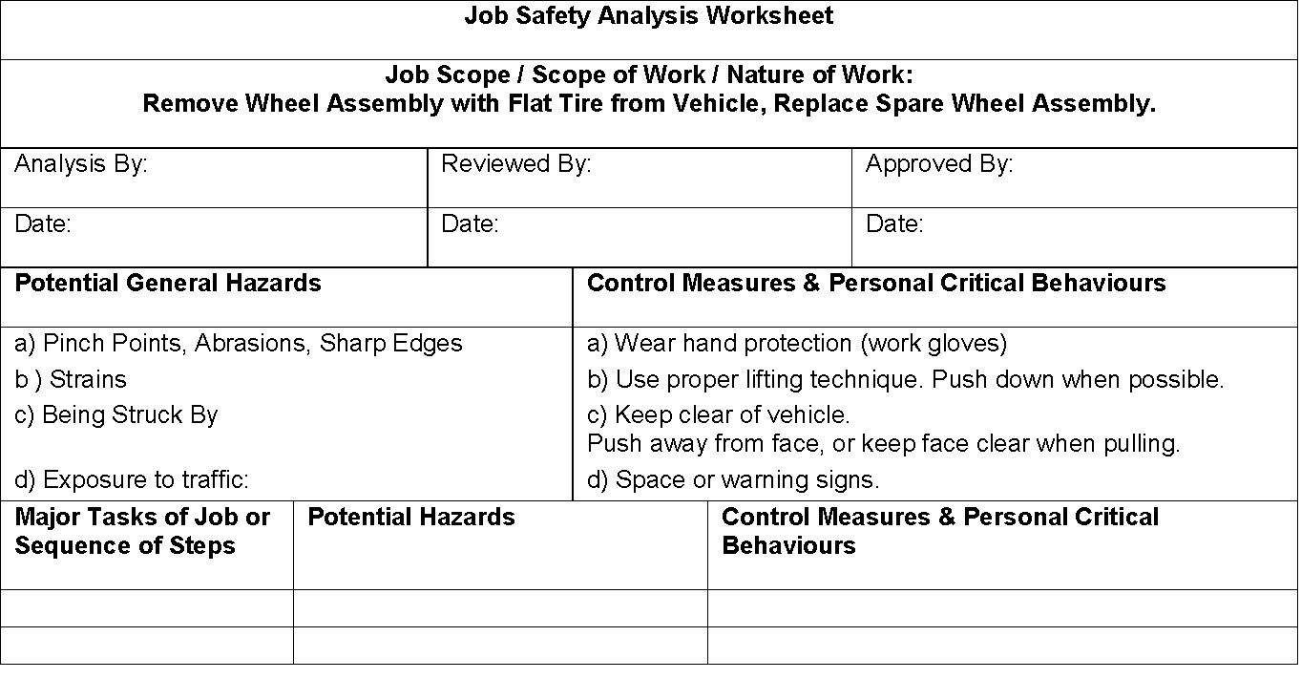
The JSA Form – Let’s Change a Tire:
Chapter 5.5: The CCOHS Model for Job Safety Analysis
20
Notes:
20

Slide 21
On Becoming a Leader in Risk Management
Fundamentals of RM
RM System and Process
Leadership in RM
Incident Investigation
RM Tools & Challenges
RM in Industry
People & Org.
Application and Perspectives
ENGG404
Chapter 5.6: Checklists for Executing Work
Notes:
ENGG404 Lecture 00 - Day 1
2012 Fall
21
21

Slide 22
Risk Management Tools:
FLRAs
SQRAs
CCOHS JSAs
Check-lists
Planned Inspections & Audits
Chapter 5.1: Tools for Risk Management
22

Slide 23
Checklists
Checklists are tools for planned inspections with the objectives of avoiding substandard conditions, therefore controlling risk.
These have been developed by experts in the activities being analyzed.
Should be complemented by other tools (e.g. Job Safety Analysis) and procedures (e.g. Safe Operating Procedures).
Classic example: The airline crew pre-flight checklist (short duration, one set of workers)
Health care example: The pre and post surgery checklist for surgical teams
Engineering example: vehicle walk around checklist before using your company truck.
23
Notes:
23

Slide 24
Limitations and Drawbacks of Checklists:
Too narrow: does not cover every anticipated need or every situation.
If not carefully observant, hazards / deficiencies can be overlooked.
Can become very long, tedious.
Perfunctory fashion (so called “checking the boxes” or “pencil whipping exercise”).
Outcome: impact on culture …
Complacency sets in with repeated use and lack of leadership support; thus, an opportunity for leadership in risk management.
This an opportunity for leadership. So, what can leaders do to combat complacency?
Chapter 5.6: Checklists for Executing Work
24
Notes:
24

Slide 25
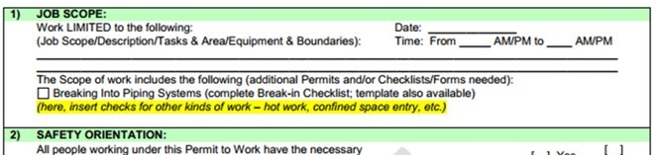
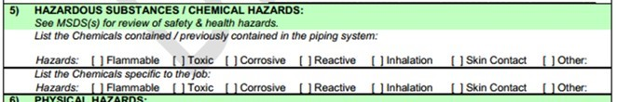
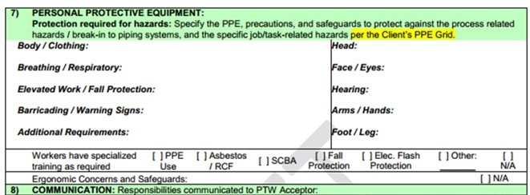
Specialized Permit-to-Work Checklist:
Chapter 5.6: Checklists for Executing Work
25
Notes:
25

Slide 26
In Summary:
The Job Safety Analysis method provides a systematic tool to identify hazards associated with any activity, and to specify the appropriate control measures.
This systematic tool can be complemented with the application of incident models and knowledge-based approaches for hazard identification.
Provides a method for developing safe work procedures (administrative controls), following the identification of these hazards and their control.
FLRA, SQRA, and JSA are all similar in approach but have applications best suited for the job or activity!
Chapter 5.5: The CCOHS Model for Job Safety Analysis
26
Notes:
26

